Slide 1
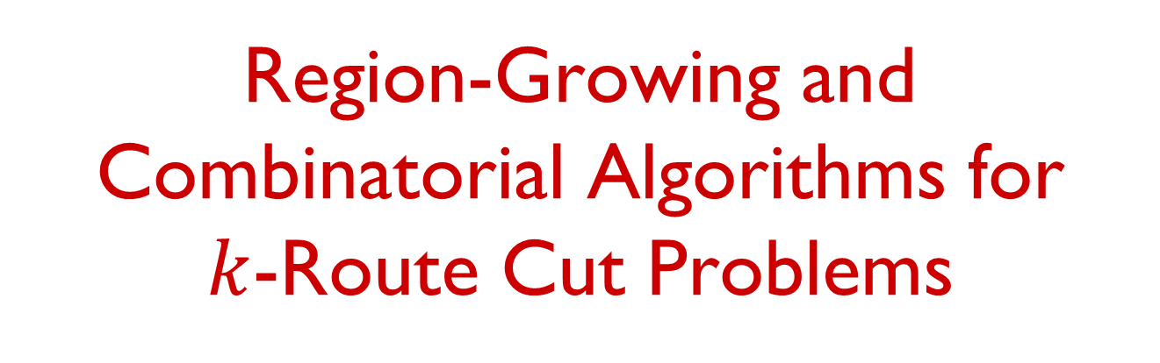
Region-Growing and Combinatorial Algorithms for
$k$-Route Cut Problems
Chaitanya Swamy
University of Waterloo
Joint work with
Guru Guruganesh and Laura Sanita
CMU University of Waterloo

Slide 2

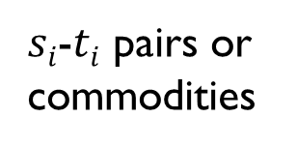

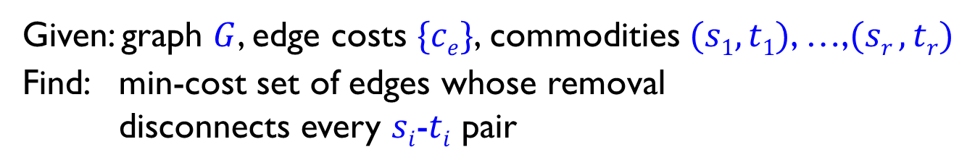




Multicut problem
$$s1$$
$$t2$$
$si$-$ti$ pairs or commodities
$$s2$$
$$s3$$
$$t3$$
$$t1$$
Given: graph $G$, edge costs $\{ce\}$, commodities $(s1, t1)$, …,$(sr , tr)$
Find: min-cost set of edges whose removal
disconnects every $si$-$ti$ pair

Slide 3
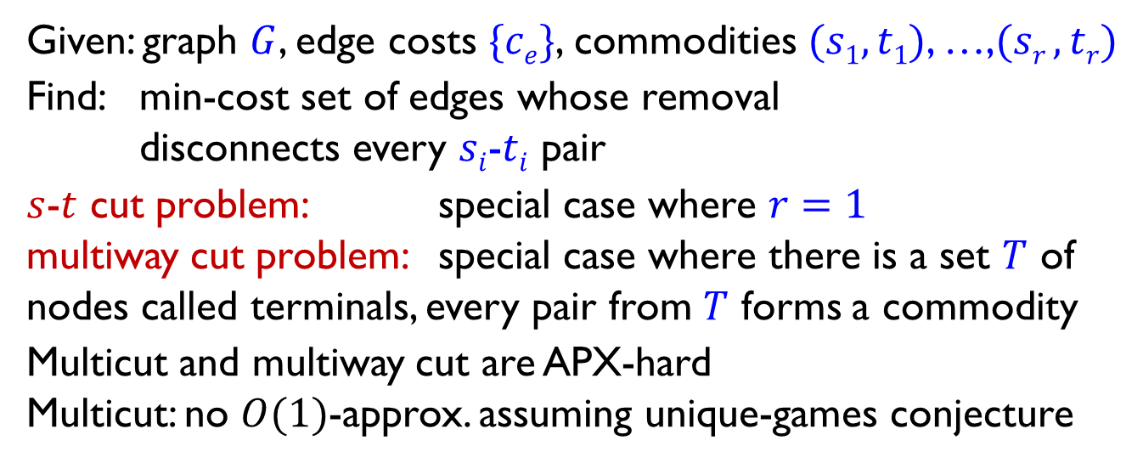
Multicut problem
$$s1$$
$$t2$$
$si$-$ti$ pairs or commodities
$$s2$$
$$s3$$
$$t3$$
feasible multicut solution
$$t1$$
Given: graph $G$, edge costs $\{ce\}$, commodities $(s1, t1)$, …,$(sr , tr)$
Find: min-cost set of edges whose removal
disconnects every $si$-$ti$ pair
$s$-$t$ cut problem: special case where $r=1$
multiway cut problem: special case where there is a set $T$ of nodes called terminals, every pair from $T$ forms a commodity
Multicut and multiway cut are APX-hard
Multicut: no $O(1)$-approx. assuming unique-games conjecture

Slide 4

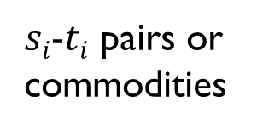




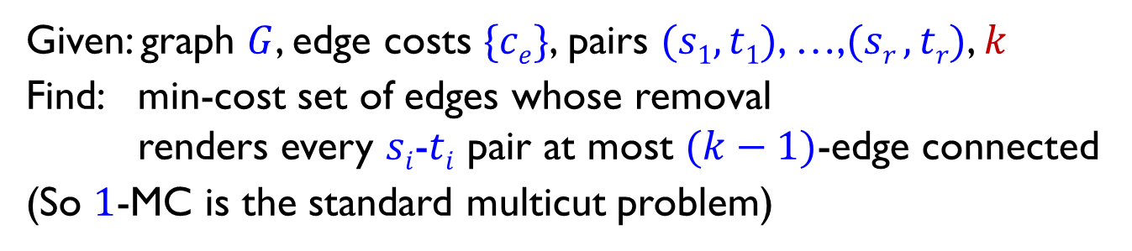


$k$-route multicut ($k$-MC)
$$s1$$
$$t2$$
$si$-$ti$ pairs or commodities
$$s2$$
$$s3$$
$$t3$$
$$t1$$
Given: graph $G$, edge costs $\{ce\}$, pairs $(s1, t1)$, …,$(sr , tr)$, $k$
Find: min-cost set of edges whose removal
renders every $si$-$ti$ pair at most $(k−1)$-edge connected
(So $1$-MC is the standard multicut problem)

Slide 5

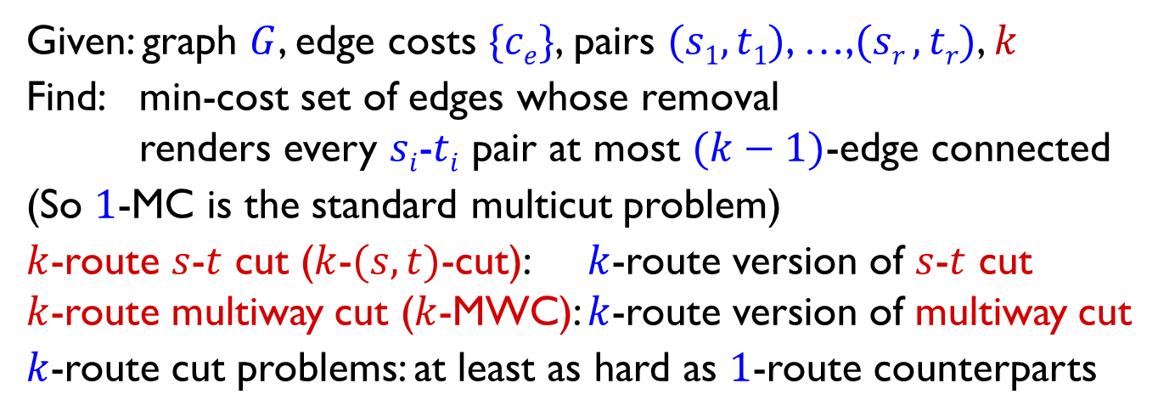



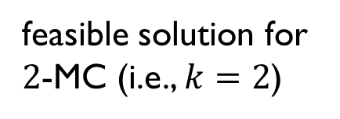


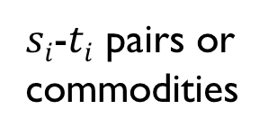

$k$-route multicut ($k$-MC)
$$s1$$
$$t2$$
$si$-$ti$ pairs or commodities
$$s2$$
$$s3$$
$$t3$$
feasible solution for $2$-MC (i.e., $k=2$)
$$t1$$
Given: graph $G$, edge costs $\{ce\}$, pairs $(s1, t1)$, …,$(sr , tr)$, $k$
Find: min-cost set of edges whose removal
renders every $si$-$ti$ pair at most $(k−1)$-edge connected
(So $1$-MC is the standard multicut problem)
$k$-route $s$-$t$ cut ($k$-$(s,t)$-cut): $k$-route version of $s$-$t$ cut
$k$-route multiway cut ($k$-MWC): $k$-route version of multiway cut
$k$-route cut problems: at least as hard as $1$-route counterparts

Slide 6
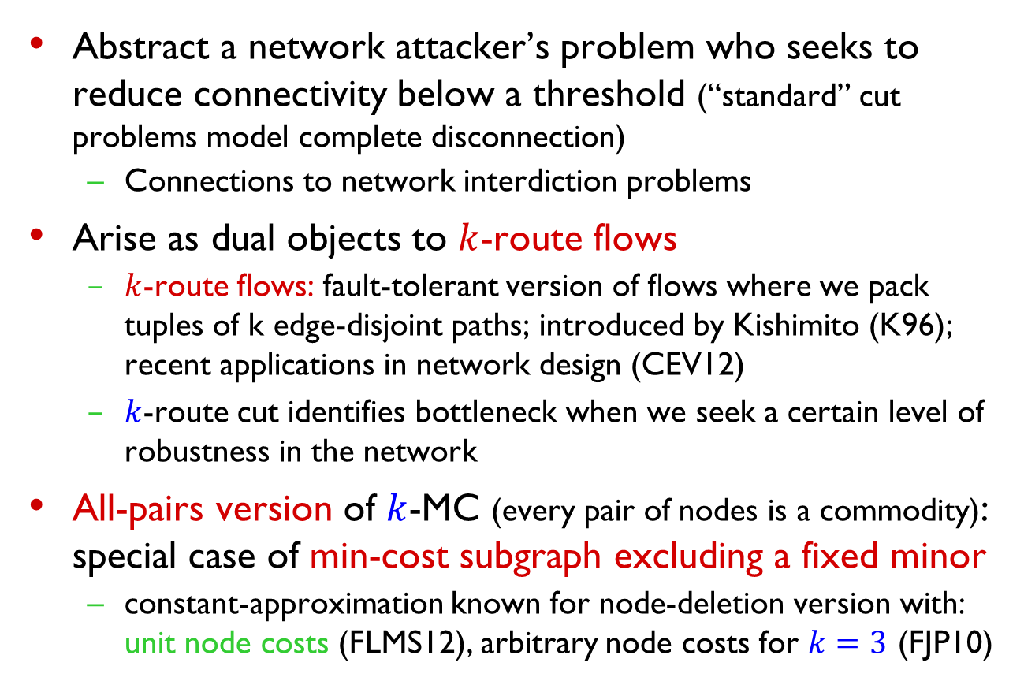

Motivation for $k$-route cuts
Abstract a network attacker’s problem who seeks to reduce connectivity below a threshold (“standard” cut problems model complete disconnection)
  Connections to network interdiction problems
Arise as dual objects to $k$-route flows
  $k$-route flows: fault-tolerant version of flows where we pack tuples of k edge-disjoint paths; introduced by Kishimito (K96); recent applications in network design (CEV12)
  $k$-route cut identifies bottleneck when we seek a certain level of robustness in the network
All-pairs version of $k$-MC (every pair of nodes is a commodity): special case of min-cost subgraph excluding a fixed minor
  constant-approximation known for node-deletion version with: unit node costs (FLMS12), arbitrary node costs for $k=3$ (FJP10)

Slide 7
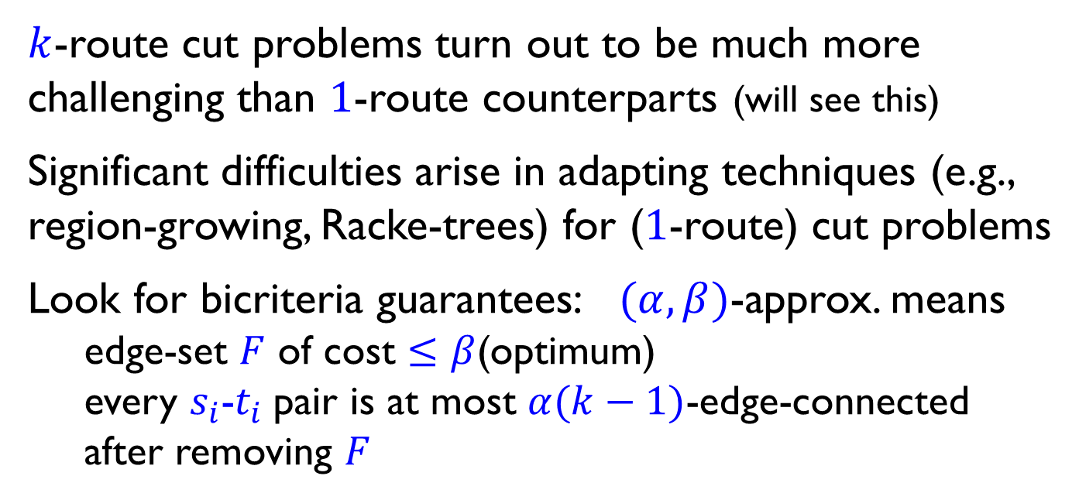
$k$-route cut problems turn out to be much more challenging than $1$-route counterparts (will see this)
Significant difficulties arise in adapting techniques (e.g., region-growing, Racke-trees) for ($1$-route) cut problems
Look for bicriteria guarantees: $(α,β)$-approx. means
edge-set $F$ of cost $≤β$(optimum)
every $s_{i}$-$t_{i}$pair is at most $α(k−1)$-edge-connected after removing $F$

Slide 8
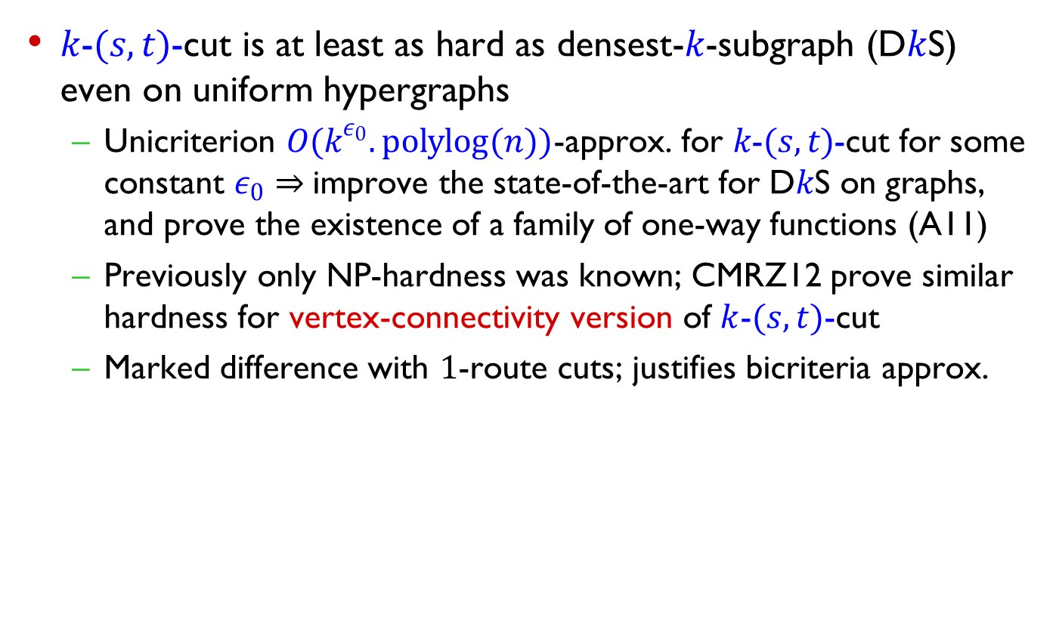
Our results
$k$-$(s,t)$-cut is at least as hard as densest-$k$-subgraph (D$k$S) even on uniform hypergraphs
  Unicriterion $O(k^{ε_{0}}.polylog(n))$-approx. for $k$-$(s,t)$-cut for some constant $ε_{0}⇒$improve the state-of-the-art for D$k$S on graphs, and prove the existence of a family of one-way functions (A11)
  Previously only NP-hardness was known; CMRZ12 prove similar hardness for vertex-connectivity version of $k$-$(s,t)$-cut
  Marked difference with $1$-route cuts; justifies bicriteria approx.

Slide 9
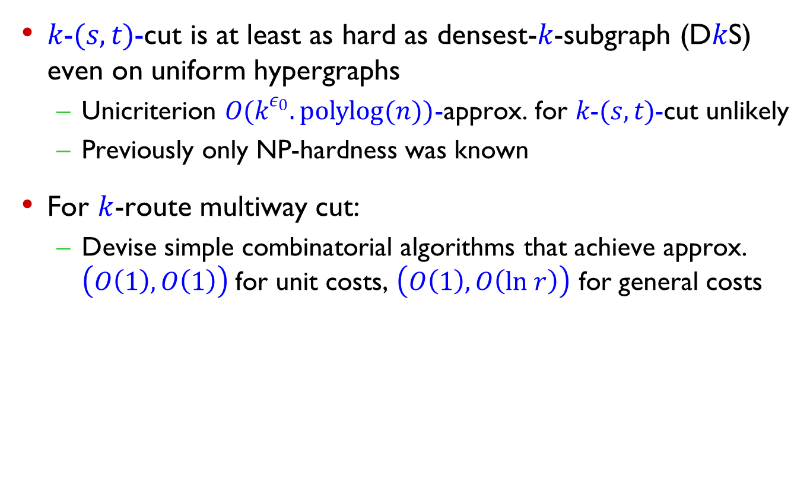
Our results
$k$-$(s,t)$-cut is at least as hard as densest-$k$-subgraph (D$k$S) even on uniform hypergraphs
  Unicriterion $O(k^{ε_{0}}.polylog(n))$-approx. for $k$-$(s,t)$-cut unlikely
  Previously only NP-hardness was known
For $k$-route multiway cut:
  Devise simple combinatorial algorithms that achieve approx. $\left(O\left(1\right), O\left(1\right)\right)$for unit costs, $\left(O\left(1\right), O\left(ln r\right)\right)$ for general costs
approximation in connectivity
approximation in cost

Slide 10
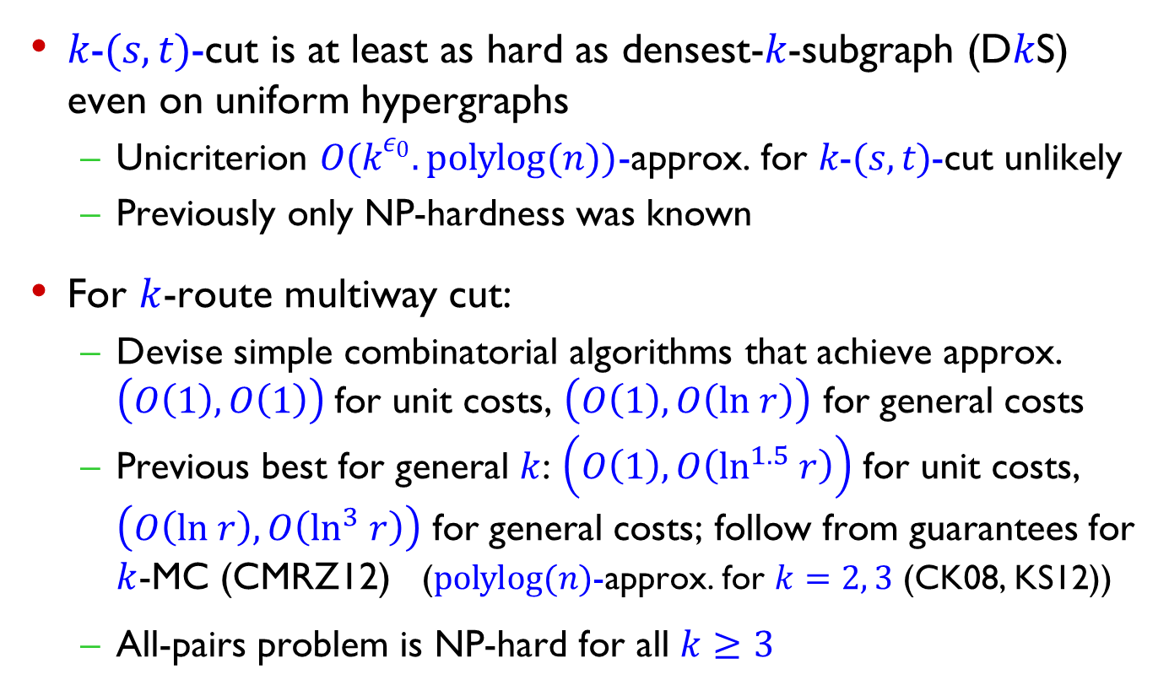
Our results
$k$-$(s,t)$-cut is at least as hard as densest-$k$-subgraph (D$k$S) even on uniform hypergraphs
  Unicriterion $O(k^{ε_{0}}.polylog(n))$-approx. for $k$-$(s,t)$-cut unlikely
  Previously only NP-hardness was known
For $k$-route multiway cut:
  Devise simple combinatorial algorithms that achieve approx. $\left(O\left(1\right), O\left(1\right)\right)$for unit costs, $\left(O\left(1\right), O\left(ln r\right)\right)$ for general costs
  Previous best for general $k$: $\left(O\left(1\right), O\left(\ln^{1.5} r\right)\right)$ for unit costs, $\left(O\left(ln r\right), O\left(\ln^{3} r\right)\right)$ for general costs; follow from guarantees for $k$-MC (CMRZ12) ($polylog(n)$-approx. for $k=2, 3$ (CK08, KS12))
  All-pairs problem is NP-hard for all $k≥3$

Slide 11
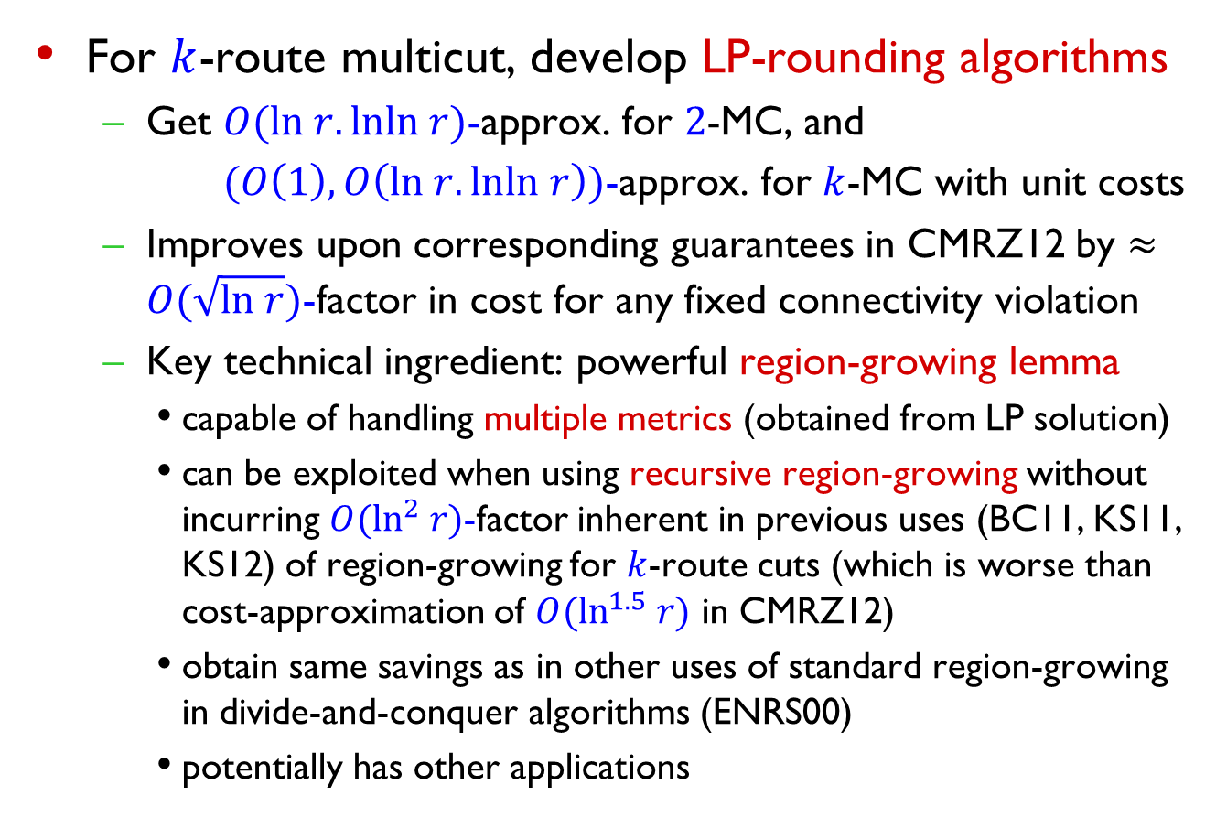
Our results (contd.)
For $k$-route multicut, develop LP-rounding algorithms
  Get $O(ln r.lnln r)$-approx. for $2$-MC, and
  $(O\left(1\right), O\left(ln r.lnln r\right))$-approx. for $k$-MC with unit costs
  Improves upon corresponding guarantees in CMRZ12 by $≈O(\sqrt{ln r})$-factor in cost for any fixed connectivity violation
  Key technical ingredient: powerful region-growing lemma
    capable of handling multiple metrics (obtained from LP solution)
    can be exploited when using recursive region-growing without incurring $O(\ln^{2} r)$-factor inherent in previous uses (BC11, KS11, KS12) of region-growing for $k$-route cuts (which is worse than cost-approximation of $O(\ln^{1.5} r)$ in CMRZ12)
    obtain same savings as in other uses of standard region-growing in divide-and-conquer algorithms (ENRS00)
    potentially has other applications

Slide 12
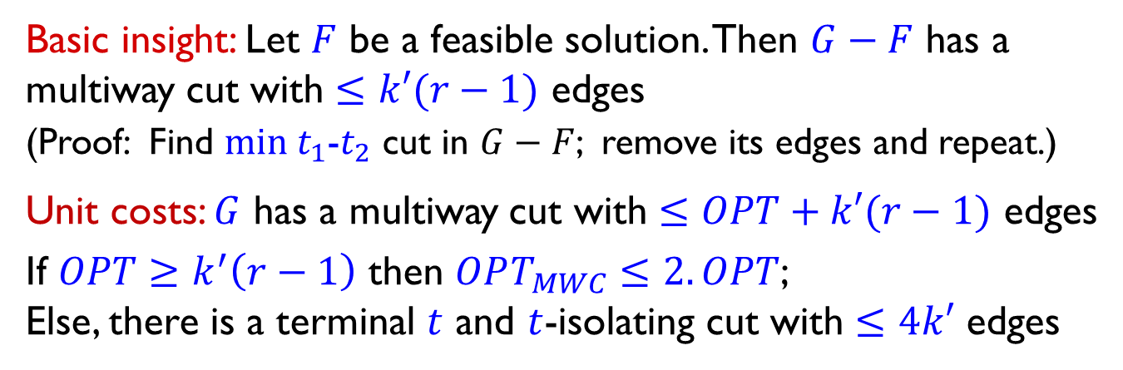

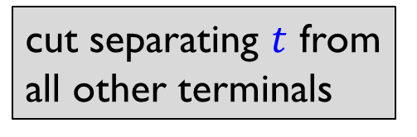
$k$-MWC: combinatorial algorithm
$k^{′}=k−1$ $T$: terminal-set, $r=|T|$, $OPT=$optimal value
Basic insight: Let $F$ be a feasible solution. Then $G−F$ has a multiway cut with $≤k′(r−1)$ edges
(Proof: Find $min t_{1}$-$t_{2}$ cut in $G−F$; remove its edges and repeat.)
Unit costs: $G$ has a multiway cut with $≤OPT+k′(r−1)$ edges
If $OPT≥k^{′}\left(r−1\right)$ then $OPT_{MWC}≤2.OPT$;
Else, there is a terminal $t$ and $t$-isolating cut with $≤4k′$ edges
cut separating $t$ from all other terminals

Slide 13
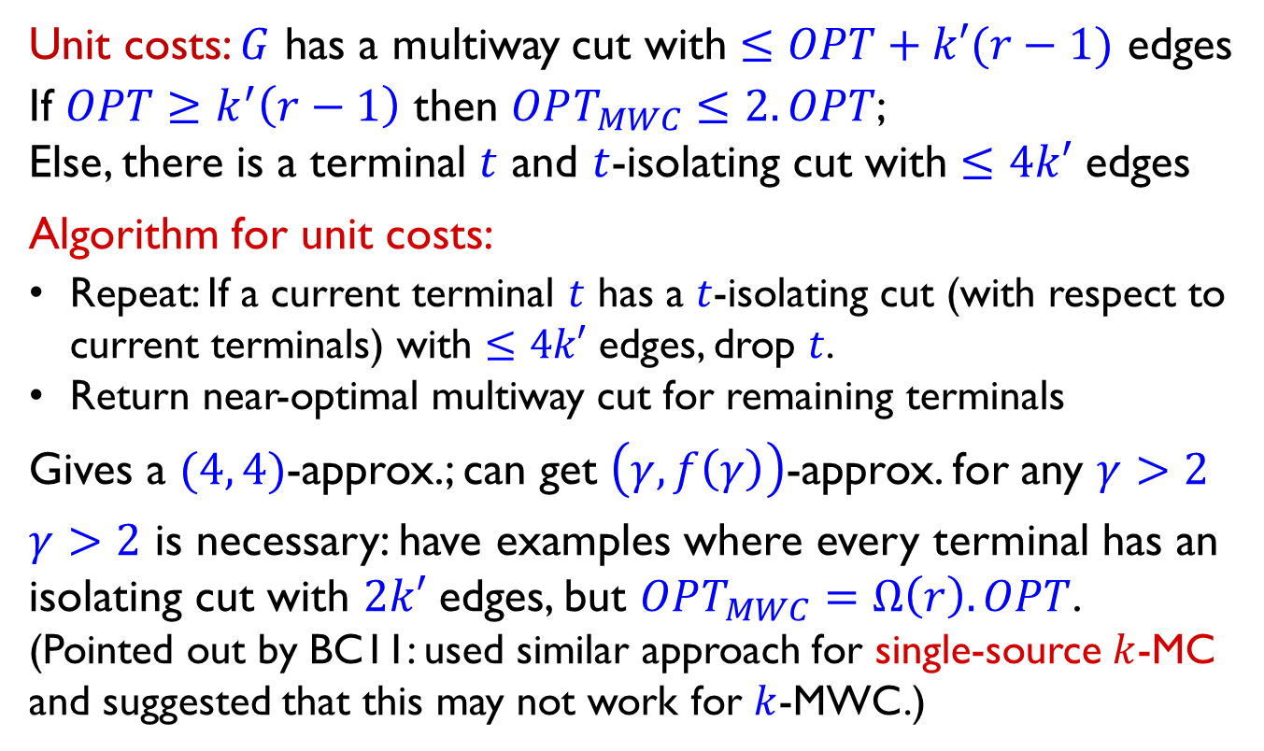
$k$-MWC: combinatorial algorithm
$k^{′}=k−1$ $T$: terminal-set, $r=|T|$, $OPT=$optimal value
Unit costs: $G$ has a multiway cut with $≤OPT+k′(r−1)$ edges
If $OPT≥k^{′}\left(r−1\right)$ then $OPT_{MWC}≤2.OPT$;
Else, there is a terminal $t$ and $t$-isolating cut with $≤4k′$ edges
Algorithm for unit costs:
Repeat: If a current terminal $t$ has a $t$-isolating cut (with respect to current terminals) with $≤4k′$ edges, drop $t$.
Return near-optimal multiway cut for remaining terminals
Gives a $(4, 4)$-approx.; can get $\left(γ,f\left(γ\right)\right)$-approx. for any $γ>2$
$γ>2$ is necessary: have examples where every terminal has an isolating cut with $2k′$ edges, but $OPT_{MWC}=Ω\left(r\right).OPT$.
(Pointed out by BC11: used similar approach for single-source $k$-MC and suggested that this may not work for $k$-MWC.)

Slide 14
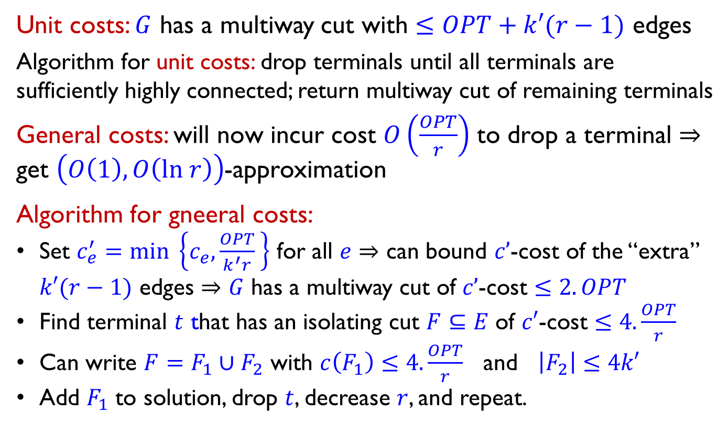
$k$-MWC: combinatorial algorithm
$k^{′}=k−1$ $T$: terminal-set, $r=|T|$, $OPT=$optimal value
Unit costs: $G$ has a multiway cut with $≤OPT+k′(r−1)$ edges
Algorithm for unit costs: drop terminals until all terminals are sufficiently highly connected; return multiway cut of remaining terminals
General costs: will now incur cost $O\left(\frac{OPT}{r}\right)$ to drop a terminal $⇒$
get $\left(O\left(1\right), O\left(ln r\right)\right)$-approximation
Algorithm for gneeral costs:
Set $c_{e}^{′}=min \left\{c_{e},\frac{OPT}{k^{′}r} \right\}$ for all $e$ $⇒$ can bound $c’$-cost of the “extra” $k′(r−1)$ edges $⇒$ $G$ has a multiway cut of $c’$-cost $≤2.OPT$
Find terminal $t$ that has an isolating cut $F⊆E$ of $c′$-cost $≤4.\frac{OPT}{r}$
Can write $F=F_{1}∪F_{2}$ with $c\left(F_{1}\right)≤4.\frac{OPT}{r}$ and $\left|F_{2}\right|≤4k′$
Add $F_{1}$ to solution, drop $t$, decrease $r$, and repeat.

Slide 15
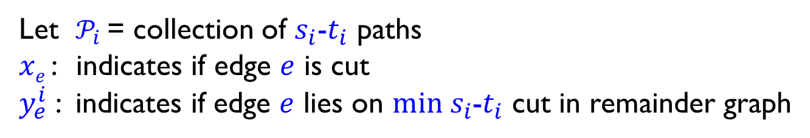

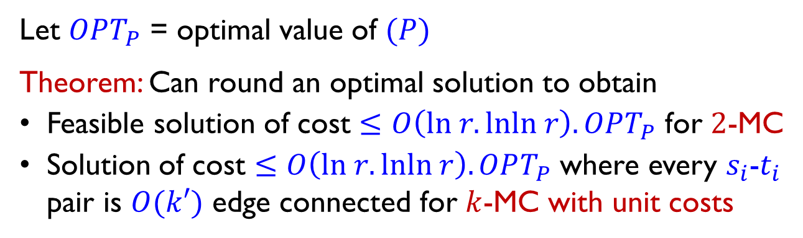
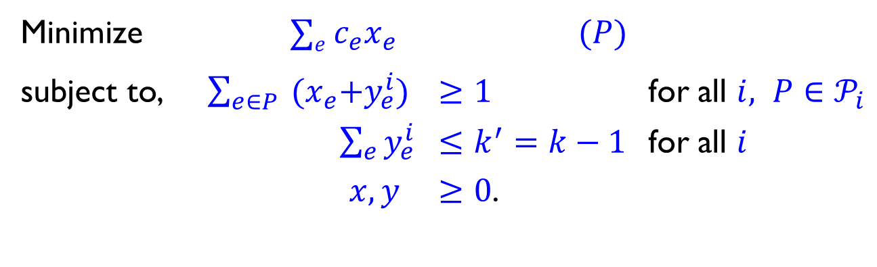
Linear program (LP) for $k$-MC
Let $𝒫_{i}$ = collection of $s_{i}$-$t_{i}$ paths
$xe$ : indicates if edge $e$ is cut
$y_{e}^{i}$ : indicates if edge $e$ lies on $min s_{i}$-$t_{i}$ cut in remainder graph
Minimize $∑e c_{e}x_{e}$ $(P)$
subject to, $\sum_{e∈P}{{ (x}_{e}+y_{e}^{i}) }$ $≥1$ for all $i, P∈𝒫_{i}$
$\sum_{e}{y_{e}^{i}}$ $≤k^{′}=k−1$ for all $i$
$x, y$ $≥0$.
Let $OPT_{P}$ = optimal value of $(P)$
Theorem: Can round an optimal solution to obtain
Feasible solution of cost $≤O\left(ln r.lnln r\right).OPT_{P}$ for $2$-MC
Solution of cost $≤O\left(ln r.lnln r\right).OPT_{P}$ where every $s_{i}$-$t_{i}$ pair is $O(k′)$ edge connected for $k$-MC with unit costs

Slide 16
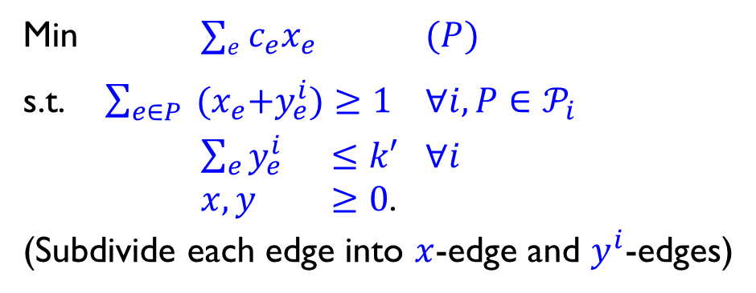
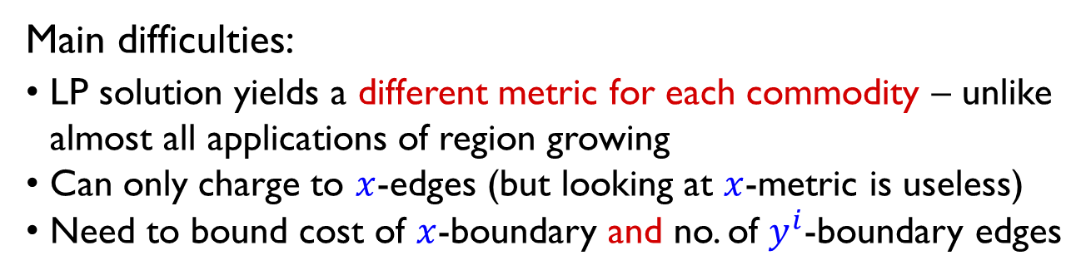
Region growing
Useful tool for cut problems: View LP solution as a metric
Grow a suitable ball in this metric and show that:
(cost of boundary edges) can be charged to (volume of ball)
Min $∑e c_{e}x_{e}$ $(P)$
s.t. $\sum_{e∈P}{{ (x}_{e}+y_{e}^{i})}≥1$ $∀i, P∈𝒫_{i}$
$\sum_{e}{y_{e}^{i}}$ $≤k′$ $∀i$
$x, y$ $≥0$.
(Subdivide each edge into $x$-edge and $y^{i}$-edges)
contribution of edges (partly) inside ball to LP objective
Main difficulties:
LP solution yields a different metric for each commodity – unlike almost all applications of region growing
Can only charge to $x$-edges (but looking at $x$-metric is useless)
Need to bound cost of $x$-boundary and no. of $y^{i}$-boundary edges

Slide 17
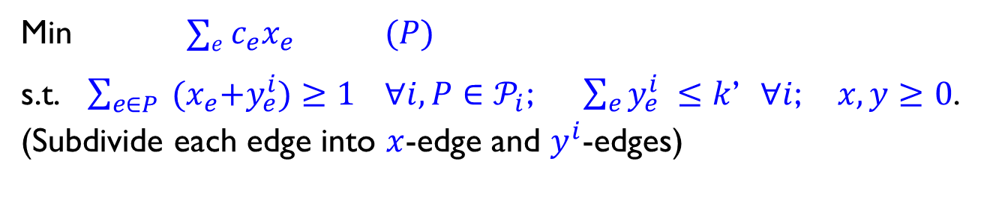

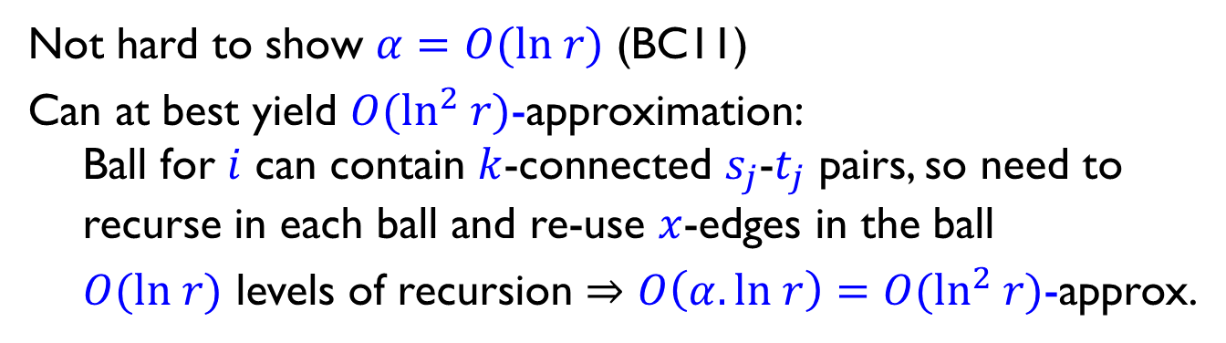
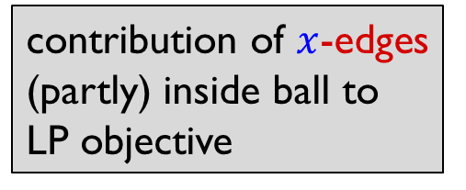
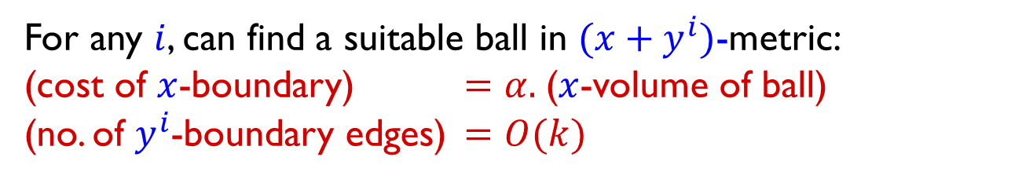
Region growing for $k$-route cut
Min $∑e c_{e}x_{e}$ $(P)$
s.t. $\sum_{e∈P}{{ (x}_{e}+y_{e}^{i})}≥1$ $∀i, P∈𝒫_{i}$; $\sum_{e}{y_{e}^{i}} ≤k$’ $∀i$; $x, y≥0$.
(Subdivide each edge into $x$-edge and $y^{i}$-edges)
For any $i$, can find a suitable ball in $(x+y^{i})$-metric:
(cost of $x$-boundary) $=α.$($x$-volume of ball)
(no. of $y^{i}$-boundary edges) $=O(k)$
contribution of $x$-edges (partly) inside ball to LP objective
Not hard to show $α=O(ln r)$ (BC11)
Can at best yield $O(\ln^{2} r)$-approximation:
Ball for $i$ can contain $k$-connected $s_{j}$-$t_{j}$ pairs, so need to recurse in each ball and re-use $x$-edges in the ball
$O(ln r)$ levels of recursion $⇒O\left(α.ln r\right)=O(\ln^{2} r)$-approx.

Slide 18
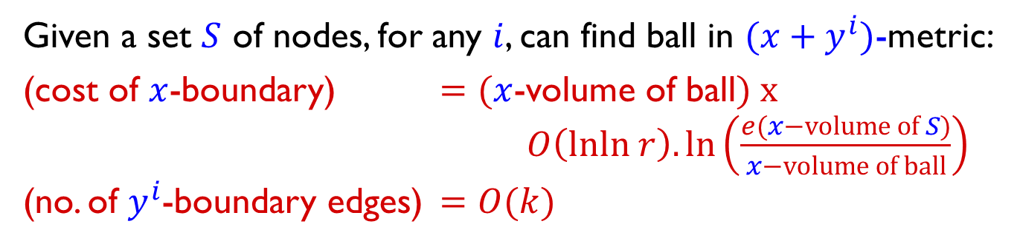

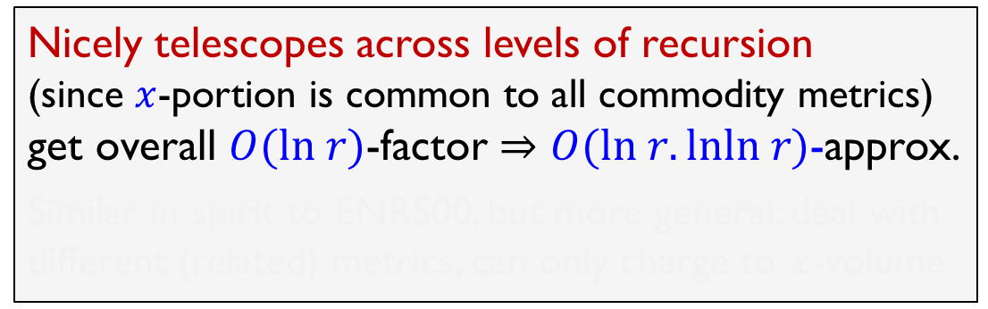
Our region-growing lemma
Min $∑e c_{e}x_{e}$ $(P)$
s.t. $\sum_{e∈P}{{ (x}_{e}+y_{e}^{i})}≥1$ $∀i, P∈𝒫_{i}$; $\sum_{e}{y_{e}^{i}} ≤k′$ $∀i$; $x, y≥0$.
(Subdivide each edge into $x$-edge and $y^{i}$-edges)
Given a set $S$ of nodes, for any $i$, can find ball in $(x+y^{i})$-metric:
(cost of $x$-boundary) $=$ $(x$-volume of ball$) x$ $O\left(lnln r\right). ln\left(\frac{e(x−volume of S)}{x−volume of ball}\right)$
(no. of $y^{i}$-boundary edges) $=O(k)$
Nicely telescopes across levels of recursion
(since $x$-portion is common to all commodity metrics)
get overall $O(ln r)$-factor $⇒O(ln r.lnln r)$-approx.
Similar in spirit to ENRS00, but more general: deal with different (related) metrics, can only charge to $x$-volume

Slide 19
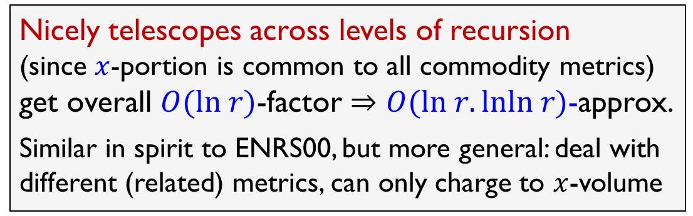
Our region-growing lemma
Min $∑e c_{e}x_{e}$ $(P)$
s.t. $\sum_{e∈P}{{ (x}_{e}+y_{e}^{i})}≥1$ $∀i, P∈𝒫_{i}$; $\sum_{e}{y_{e}^{i}} ≤k′$ $∀i$; $x, y≥0$.
(Subdivide each edge into $x$-edge and $y^{i}$-edges)
Given a set $S$ of nodes, for any $i$, can find ball in $(x+y^{i})$-metric:
(cost of $x$-boundary) $=$ $(x$-volume of ball$) x$ $O\left(lnln r\right). ln\left(\frac{e(x−volume of S)}{x−volume of ball}\right)$
(no. of $y^{i}$-boundary edges) $=O(k)$
Nicely telescopes across levels of recursion
(since $x$-portion is common to all commodity metrics)
get overall $O(ln r)$-factor $⇒O(ln r.lnln r)$-approx.
Similar in spirit to ENRS00, but more general: deal with different (related) metrics, can only charge to $x$-volume

Slide 20
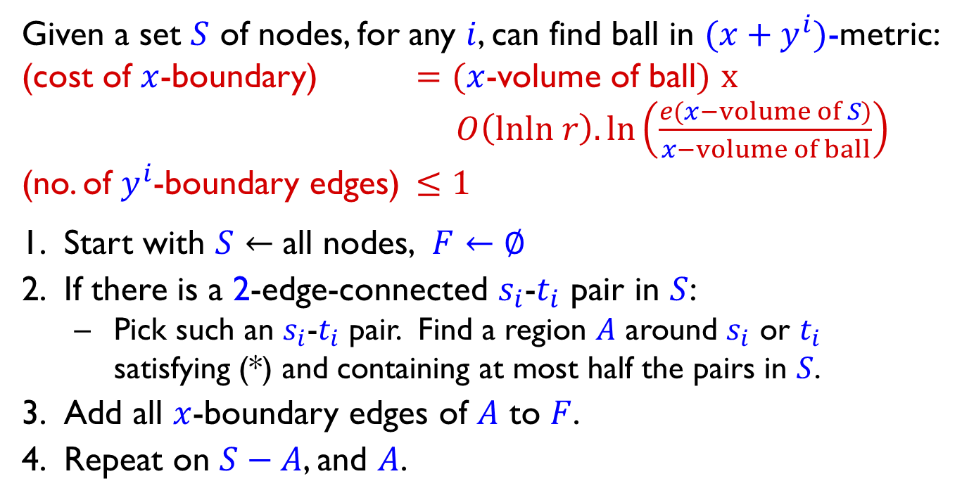

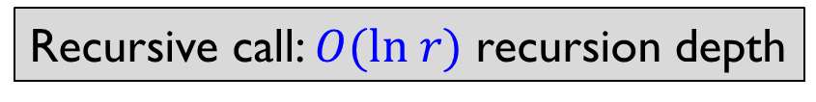

Rounding algorithm for $2$-MC
Given a set $S$ of nodes, for any $i$, can find ball in $(x+y^{i})$-metric:
(cost of $x$-boundary) $=$ $(x$-volume of ball$)$ $x$ $O\left(lnln r\right). ln\left(\frac{e(x−volume of S)}{x−volume of ball}\right)$
(no. of $y^{i}$-boundary edges) $≤1$
Start with $S←$ all nodes, $F←∅$
If there is a 2-edge-connected $s_{i}$-$t_{i}$ pair in $S$:
  Pick such an $s_{i}$-$t_{i}$ pair. Find a region $A$ around $s_{i}$ or $t_{i}$ satisfying (*) and containing at most half the pairs in $S$.
Add all $x$-boundary edges of $A$ to $F$.
Repeat on $S−A$, and $A$.
(*)
Disjoint $x$-volume
Recursive call: $O(ln r)$ recursion depth
Get $O(ln r.lnln r)$-approximation.

Slide 21

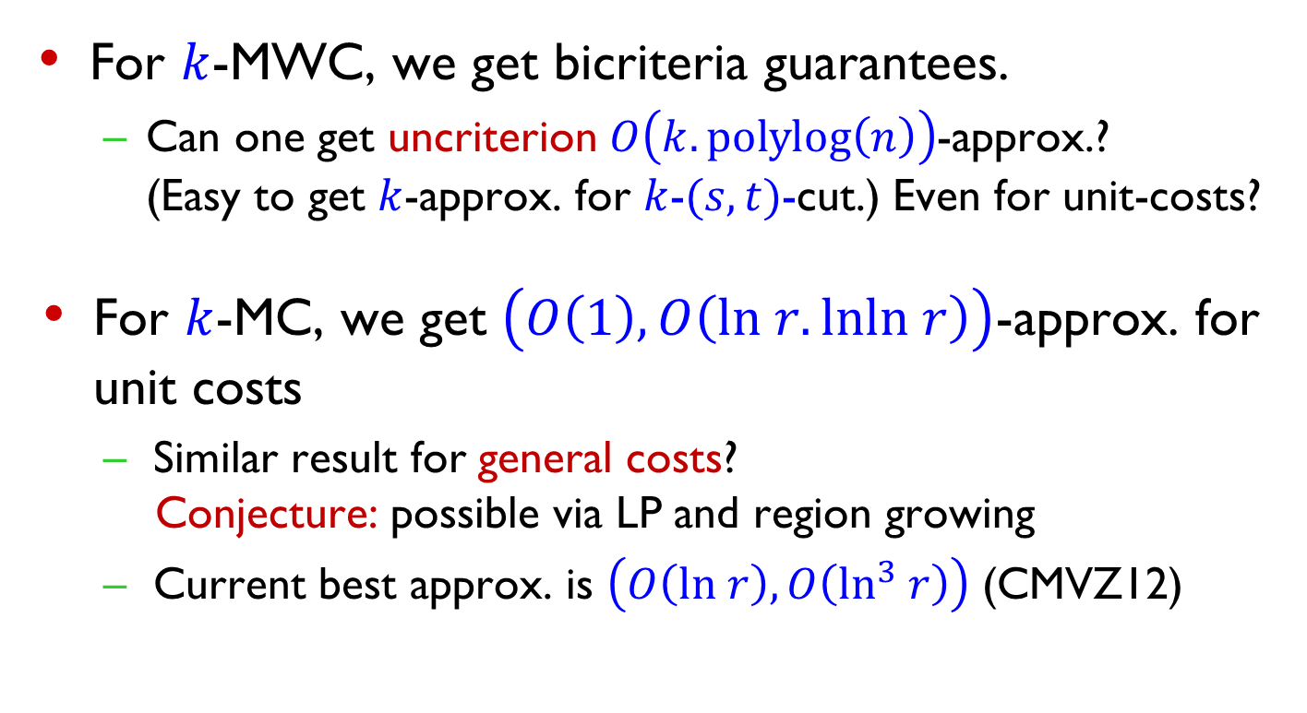
Summary and open questions
For $k$-MWC, we get bicriteria guarantees.
  Can one get uncriterion $O\left(k.polylog\left(n\right)\right)$-approx.?
  (Easy to get $k$-approx. for $k$-$(s,t)$-cut.) Even for unit-costs?
For $k$-MC, we get $\left(O\left(1\right), O\left(ln r.lnln r\right)\right)$-approx. for unit costs
  Similar result for general costs?
  Conjecture: possible via LP and region growing
  Current best approx. is $\left(O\left(ln r\right), O\left(\ln^{3} r\right)\right)$ (CMVZ12)
Cannot avoid $k^{ε}$-factor

Slide 22
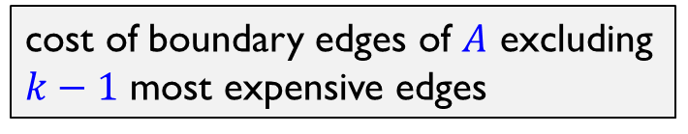
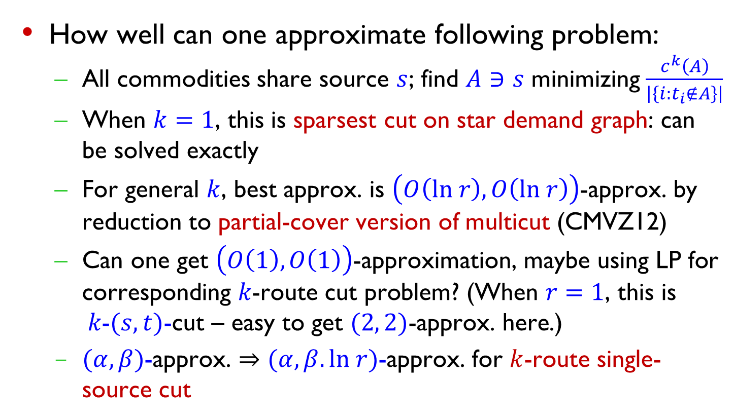
Summary and open questions
cost of boundary edges of $A$ excluding $k−1$ most expensive edges
How well can one approximate following problem:
  All commodities share source $s$; find $A∋s$ minimizing $\frac{c^{k}\left(A\right)}{\left|\left\{i:t_{i}∉A\right\}\right|}$
  When $k=1$, this is sparsest cut on star demand graph: can be solved exactly
  For general $k$, best approx. is $\left(O\left(ln r\right), O\left(ln r\right)\right)$-approx. by reduction to partial-cover version of multicut (CMVZ12)
  $\text{Can} \text{one} \text{get} \left(O\left(1\right), O\left(1\right)\right)\text{−}\text{approximation}\text{, }\text{maybe} \text{using} \text{LP} \text{for} \text{corresponding} k\text{−}\text{route} \text{cut} \text{problem}\text{? (}\text{When} r=1\text{, }\text{this} \text{is} k\text{−}(s, t)\text{−}\text{cut} \text{– }\text{easy} \text{to} \text{get} (2, 2)\text{−}\text{approx}\text{. }\text{here}\text{.)}$
  $(α, β)$-approx. $⇒(α, β.ln r)$-approx. for $k$-route single-source cut

Slide 23
Thank You

